Slide 1


Chapter 15
Evaluation: Inspections, Analytics & Models

Slide 2
Aims:
Describe the key concepts associated with inspection methods.
Explain how to do heuristic evaluation and walkthroughs.
Explain the role of analytics in evaluation.
Describe how to use Fitts’ Law – a predictive model.
Notes:
2

Slide 3
Inspections
Several kinds.
Experts use their knowledge of users & technology to review software usability.
Expert critiques can be formal or informal.
Heuristic evaluation is a review guided by a set of heuristics.
Walkthroughs involve stepping through a pre-planned scenario noting potential problems.
Notes:
3
The use of subject matter experts in the inspection of software systems to evaluate usability. The idea is to understand users through knowledge codified in heuristics, or data collected remotely, or models that predict users’ performance. NOTE: none of these methods requires users to be present during the evaluation.
Inspection methods typically involve an expert role-playing the users for whom the product is designed, analyzing aspects of the interface, and identifying any potential usability problems by using a set of guidelines.
The most well known are heuristic evaluation and cognitive walkthroughs.

Slide 4
Heuristic evaluation
Developed by Jacob Nielsen in the early 1990s.
Based on heuristics distilled from an empirical analysis of 249 usability problems.
These heuristics have been revised for current technology by Nielsen and others for:
mobile devices,
wearables,
virtual worlds, etc.
Design guidelines form a basis for developing heuristics.
Notes:
4
Heuristic evaluation is a usability inspection method that was developed by Jacob Nielsen and his colleagues (Nielsen and Mohlich 1990; Nielsen 1994), and later modified by other researchers for evaluating specific types of systems (Hollingshead and Novick, 2007).
Experts, guided by a set of usability principles known as heuristics, evaluate whether user-interface elements, such as dialog boxes, menus, navigation structure, online help and so on, conform to tried and tested principles.
The heuristics closely resemble high-level design principles (e.g. making designs consistent, reducing memory load, and using terms that users understand).

Slide 5
Revised version (2014) of Nielsen’s original heuristics
Visibility of system status.
Match between system and real world.
User control and freedom.
Consistency and standards.
Error prevention.
Recognition rather than recall.
Flexibility and efficiency of use.
Aesthetic and minimalist design.
Help users recognize, diagnose, recover from errors.
Help and documentation.
Notes:
5
The system should always keep users informed about what is going on, through feedback and reasonable time.
The system should speak the user’s language, with words, phrases and concepts familiar to the user
Users often choose system functions by mistake, and will need a clearly marked emergency exit to leave the unwanted state without having to go through an extended dialog.
Users should not have to wonder whether different words, situations or actions mean the same thing.
Eliminate error-prone conditions or check for them and present users with a confirmation option before they commit to the action
Minimize users’ memory load by making objects, actions and options visible. The user should not have to remember information from one part of the dialog to another.
Accelerators – unseen by the novice user – may often speed up the interaction for the expert user such that the system can cater to both inexperienced and experienced users. Allow users to tailor frequent actions.
Dialogs should not contain information that is irrelevant or rarely needed.
Error messages should be expressed in plain language.
Even though it is better if the system can be used without documentation, it may be necessary to provide help and documentation. Any such information should be easy to search.

Slide 6
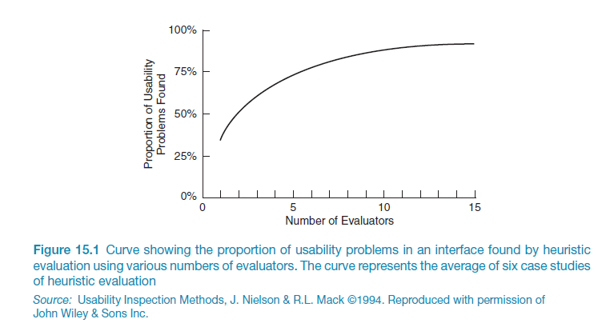
No. of evaluators & problems
Notes:
6
Exactly which heuristic is appropriate and how many are needed for different products is debatable and depends on the goals of the evaluation, but most sets of heuristics have between five and ten items. More than 10 becomes difficult for expert evaluators to remember.
A key question asked is how many evaluators are needed to carry out a thorough heuristic evaluation. While one evaluator can identify a large number of problems, they may not catch all of them, but they may have a tendency to concentrate on a specific set of functionalities (evaluator’s pet peeves).

Slide 7
Number of evaluators
Nielsen suggests that on average 5 evaluators identify 75-80% of usability problems.
Cockton and Woolrych (2001) point out that the number of users needed to find 75-80% of usability problems depends on the context and nature of the problems.
Notes:
7
More evaluators the better, but more is also expensive. There is also a point of diminishing returns.
For a quick evaluation of an early design, one or two experts can probably identify most potential usability problems, but if a thorough evaluation of a fully working prototype is needed then having a team of experts conducting the evaluation and comparing their findings would be advisable.

Slide 8
Heuristics for websites focus on key criteria (Budd, 2007)
Clarity
Make system clear, concise, and meaningful as possible.
Minimize unnecessary complexity & cognitive load
Make system as simple as possible to accomplish the task.
Provide users with context
Interface should provide users with a sense of context in time and space.
Promote positive & pleasurable user experience
Users should be treated with respect, and design should be aesthetically pleasing and promote a pleasurable and rewarding experience.
Notes:
Research Question: Are there heuristics for the expert evaluation of VR systems (perhaps even interactive virtual humans) or tangible interfaces? One way is to turn design guidelines into well formulated heuristics for a field of interaction design. More on this please read: p. 505 to 508 (Turning Design Guidelines to Heuristics).

Slide 9
3 stages for doing heuristic evaluation
Briefing session to tell experts what to do.
Evaluation period of 1-2 hours in which:
Each expert works separately;
Take one pass to get a feel for the product;
Take a second pass to focus on specific features.
Debriefing session in which experts work together to prioritize problems.
Notes:
9

Slide 10
Advantages and problems
Few ethical & practical issues to consider because users not involved.
Can be difficult & expensive to find experts.
Best experts have knowledge of application domain & users.
Biggest problems:
Important problems may get missed;
Many trivial problems are often identified;
Experts have biases.
Notes:
10
At Clemson, you may need a design IRB, if this is part of the design activity of a research study and may eventually require an empirical evaluation with users.

Slide 11
Cognitive walkthroughs
Focus on ease of learning.
Designer presents an aspect of the design & usage scenarios.
Expert is told the assumptions about user population, context of use, task details.
One or more experts walk through the design prototype with the scenario.
Experts are guided by 3 questions.
Notes:
11
-Alternate approach to heuristic evaluation for predicting users’ problems without doing user testing. Walkthough involves walking through a task with the product and noting problematic usability features. Most walkthrough methods do not involve users, but others such as the “pluralistic walkthrough” involves a team that may include users, as well as developers, and usability specialists.
Definition: “Cognitive walkthroughs involve simulating a user’s problem-solving process at each step in the human-computer dialog, checking to see if the user’s goals and memory for actions can be assumed to lead to the next correct action.” Focus is on evaluating user’s problem-solving process, meeting user’s goals and memory for actions, and successful task completion.
Steps:
Characteristics of a typical user is identified and documented and sample tasks are developed that focus on the aspects of the design to be evaluated. Prototype of the interface to be developed is also produced.
Designer and one of more expert evaluators come together to conduct the cognitive walkthrough.
The evaluators walk through the action sequence for each task, placing it within the context of a typical scenario, and as they do this they try to answer the following questions:

Slide 12
The 3 questions
Will the correct action be sufficiently evident to the user?
Will the user notice that the correct action is available?
Will the user associate and interpret the response from the action correctly? As the experts work through the scenario they note problems.
Notes:
12
I would like to think that each action as part of performing a task should leverage the following: Perception (will users know what to do?), action (see how to do it?), reaction/feedback .
Will the user know what to do to achieve the task?
Can users see the button or menu item that they should use for the next action? Is it apparent when it is needed?
Will users know from the feedback that they have made a correct or incorrect choice of actions?
Notes and summary of results is compiled, keeping an account of what works and what doesn’t, and design is then revised to fix the problems presented.

Slide 13
Pluralistic walkthrough
Variation on the cognitive walkthrough theme.
Performed by a carefully managed team.
The panel of experts begins by working separately.
Then there is managed discussion that leads to agreed decisions.
The approach lends itself well to participatory design.
Also other adaptations of basic cognitive walkthroughs.
Notes:
13
Another type of walkthrough in which, “users, developers, and usability experts work together to step through a (task) scenario, discussing usability issues associated with dialog elements involved in the scenario steps.” (Nielsen and Mack, 1994, p.5).
Each evaluator (participant user, developer, and usability expert) is asked to assume the role of a typical user
Scenarios of use, and few prototype screens are given to each evaluator who writes down the sequence of actions without consulting other panelists
Panelists discuss the actions, comes to a consensus, before moving on to the next round of screens, and comes to a consensus recommendation.
Benefits: This level of analysis is invaluable for safety-critical systems.
Limitations: having to get all the experts together at once and then proceeding at the rate of the slowest expert. Only limited number of scenarios can be examined due to time constraints.

Slide 14
Predictive models
Provide a way of evaluating products or designs without directly involving users.
Less expensive than user testing.
Usefulness limited to systems with predictable tasks - e.g., telephone answering systems, mobiles, cell and smart phones.
Based on expert error-free behavior.
Notes:
14
Predictive models evaluate a system without users being present. But the model itself may have been developed with feedback and studying how users interact with a system. But once formulated and evaluated, they are generalized resources that can be used to design the interactions.
Because of the generalizable method (will work for any user) aspect of the model, can involve expert evaluators role-playing users as in inspections, predictive models are used as formulas to derive measures of various performance.
Predictive models provides estimates of the efficiency of different systems for various kinds of tasks. For example, a smartphone designer might choose to use a predictive model because it can enable her to determine accurately which is the optimal layout of keys on the phone for allowing common operations to be performed together.

Slide 15
Fitts’ Law (Fitts, 1954)
Fitts’ Law predicts that the time to point at an object using a device is a function of the distance from the target object & the object’s size.
The further away and the smaller the object, the longer the time to locate it and point to it.
Fitts’ Law is useful for evaluating systems for which the time to locate an object is important, e.g., a cell and smart phones, a handheld and mobile devices.
Notes:
15
Originally used to predict the time it takes to reach a target using a pointing device. It was originally used in human factors research to model the relationship between speed and accuracy used when moving towards a target on a display. Help designers decide where to locate physical or digital buttons, what size they should be, and how close together they should be on a touch display or a physical device.
1. In interaction design, it has been used to describe the time it takes to point at a target, based on the size of the object and the distance to the object.
2. Direct relationship between movement time and distance to the target, and an inverse relationship between movement time and target size (area or diameter that the target occupies). The bigger the target the easier and quicker it is to reach it. This is why interfaces that have larger buttons are easier to use than interfaces that presents lots of tiny buttons crammed together.

Slide 16
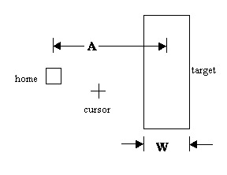
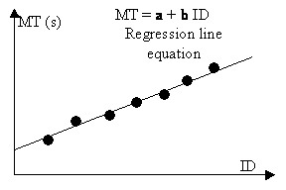
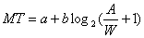
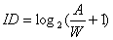
Fitts’ Law (MacKenzie Formulation)
MT: Movement Time – Time it takes to move cursor from home to target
ID: Index of Difficulty – Metric of tasks difficulty expressed as a measure of human performance in bits per section.
b: measured constant – approximately 200ms/bit.

Slide 17
Key points
Inspections can be used to evaluate requirements, mockups, functional prototypes, or systems.
User testing & heuristic evaluation may reveal different usability problems.
Design guidelines can be used to develop heuristics
• Walkthroughs are focused so are suitable for evaluating small parts of a product.
• Analytics involves collecting data about users activity on a website or product
• Fitts’ Law can be used to predict expert, error-free performance for clearly defined tasks with limited key presses, eg. data entry and smart phone use.
Notes:
17

